Slide 1
申請大專院校
Institute Application (INA)

Slide 2
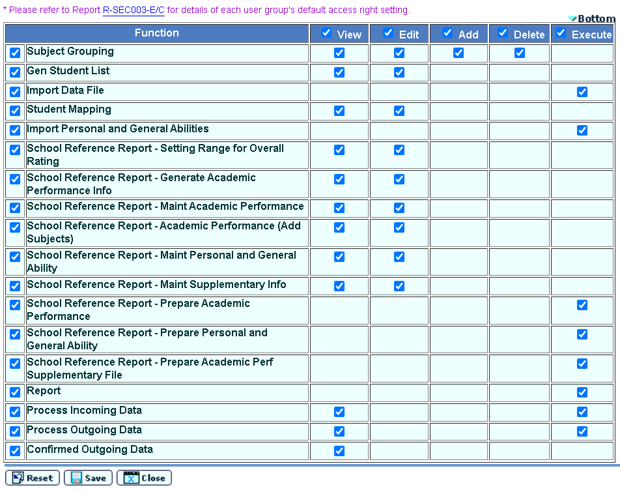
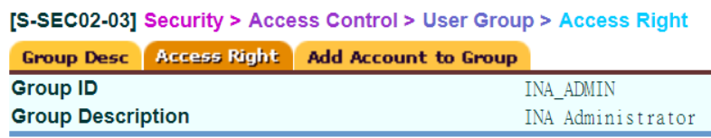
Preparatory Work 1
Access right: School head, System admin & INA admin
School head & System admin may assign access right to other staff

Slide 3
Preparatory Work 2
To facilitate data exchange between JUPAS online application system & WebSAMS, JUPAS Student List can only be available after submission of student information to JUPAS office and completion of student registration at JUPAS portal
A Data File Structure for School is posted under Download Area of school’s JUPAS account (for School Head, Teacher-in-charge & Class / Group Teacher)

Slide 4
Preparatory Work 3
If Assessment Module (ASR) is used, Academic Performance in School can be generated via School Reference Report (SRR) from WebSAMS
Can choose school year (S5 and/or S6) and assessment (e.g. T1A1, T1 or Annual) (max two entries) that best reflect students’ performance subject to schools’ selection
Exam results can be exported in Percentile and Overall Rating from WebSAMS to JUPAS online application system

Slide 5
Work Flow
For extracting S6 student data for JUPAS and E-APP applications
Sep Applications for JUPAS
Student Data Extraction and School Reference Report (SRR) Generation
- Prepare Academic Performance, Personal and General Abilities and Academic Performance Supplementary Information
- Generate SRR
Student List Generation
Submit Data via JUPAS Portal
JUPAS Student Account Creation
Import Student Registration No and Subject Code to WebSAMS
School Reference Report (SRR) Submission
Export and submit Data via JUPAS Portal
Dec Applications for E-APP
Student List and SRR Generation
Extract Student Data and generate SRR
Student Data Submission
Export Student List and SRR (optional) to E-APP Portal via CDS

Slide 6
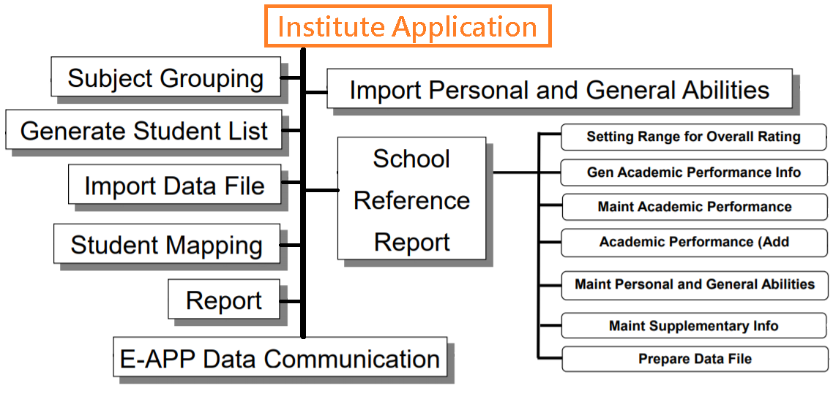
Module Flow Chart

Slide 7
申請大專院校
Institute Application (INA)

Slide 8
JUPAS
Operation Procedures

Slide 9
Work Flow
For extracting S6 student data for JUPAS and E-APP applications
Sep Applications for JUPAS
Student Data Extraction and School Reference Report (SRR) Generation
- Prepare Academic Performance, Personal and General Abilities and Academic Performance Supplementary Information
- Generate SRR
Student List Generation
Submit Data via JUPAS Portal
JUPAS Student Account Creation
Import Student Registration No and Subject Code to WebSAMS
School Reference Report (SRR) Submission
Export and submit Data via JUPAS Portal
Dec Applications for E-APP
Student List and SRR Generation
Extract Student Data and generate SRR
Student Data Submission
Export Student List and SRR (optional) to E-APP Portal via CDS

Slide 10
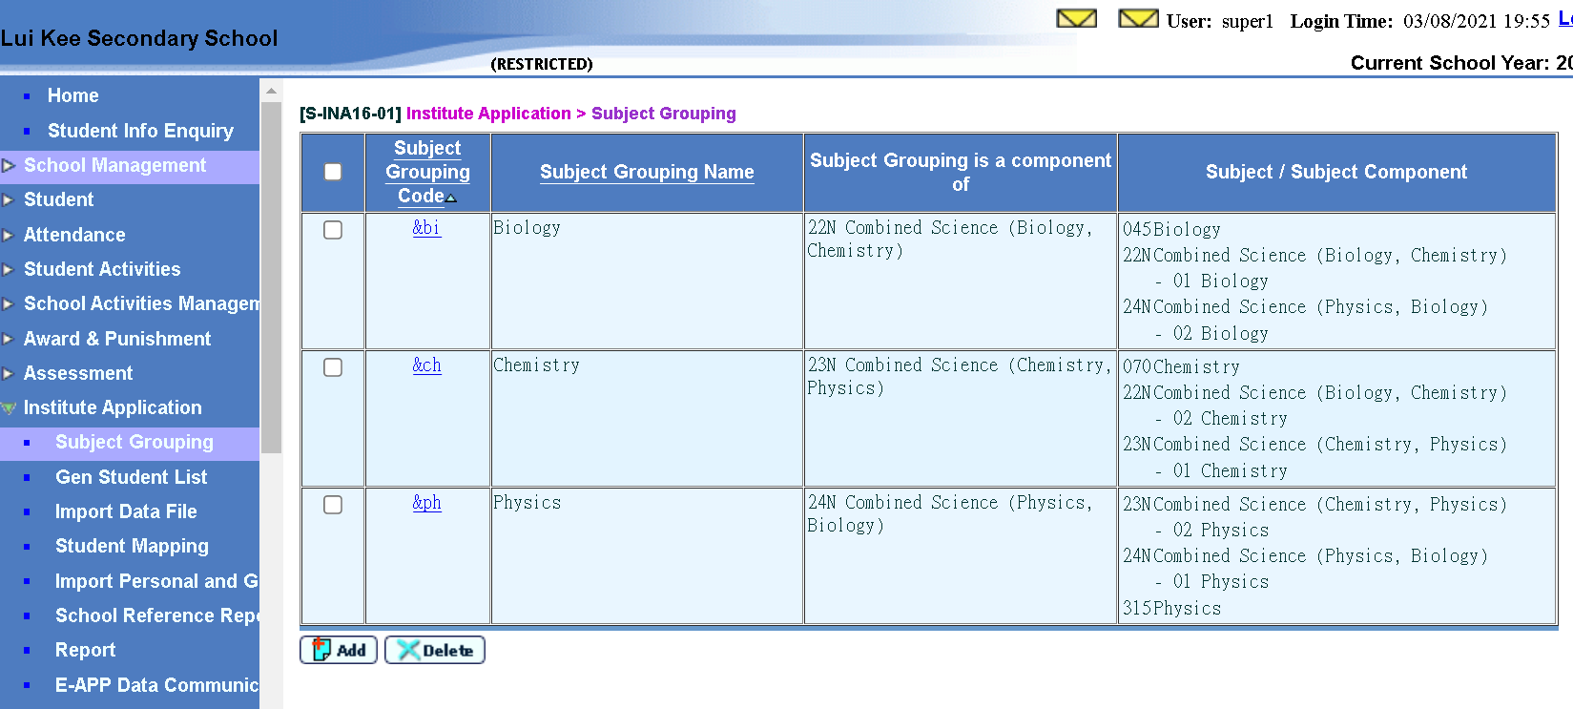
Subject Grouping
Institute Application > Subject Grouping
2
1

Slide 11
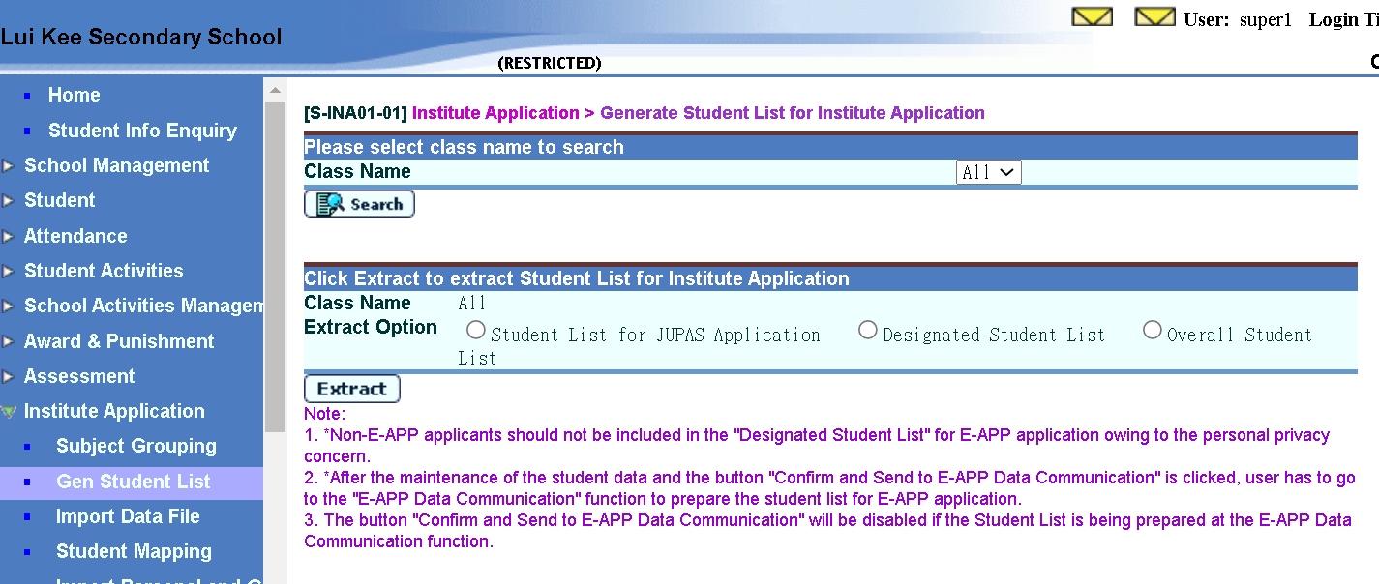
Generate Student List(1)
Institute Application > Generate Student List for Institute Application
1
2
3

Slide 12
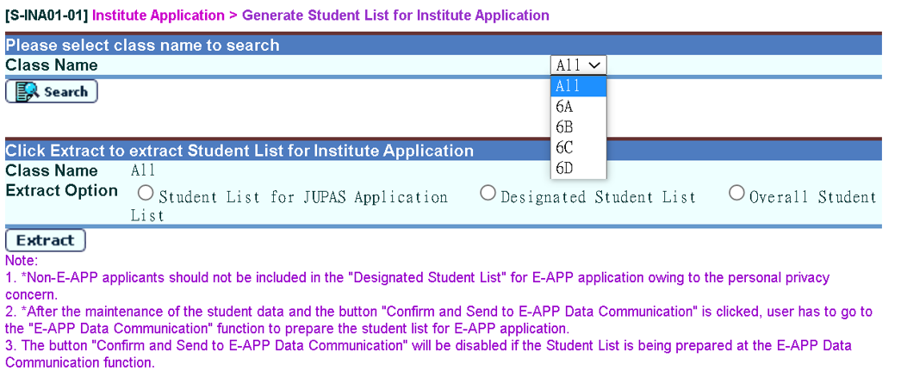
Generate Student List(2)
Institute Application > Generate Student List for Institute Application
2
1

Slide 13
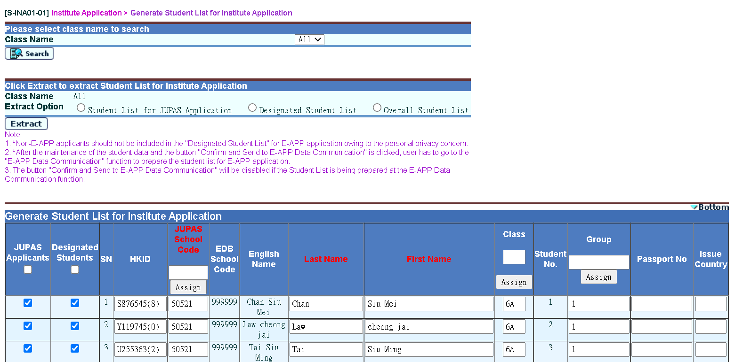
Generate Student List(3)
Institute Application > Generate Student List for Institute Application
Data under columns with header labels in red are needed to be input

Slide 14
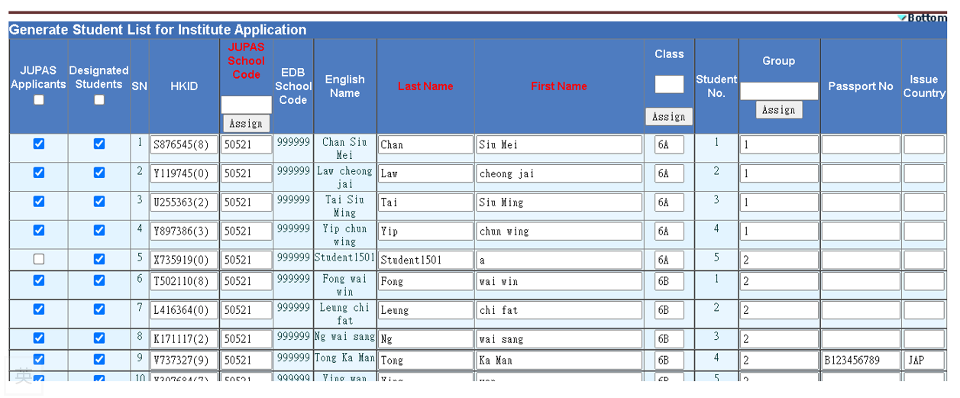
Generate Student List(4)
Institute Application > Generate Student List for Institute Application
1
2
3
4
This is provided by JUPAS Office

Slide 15
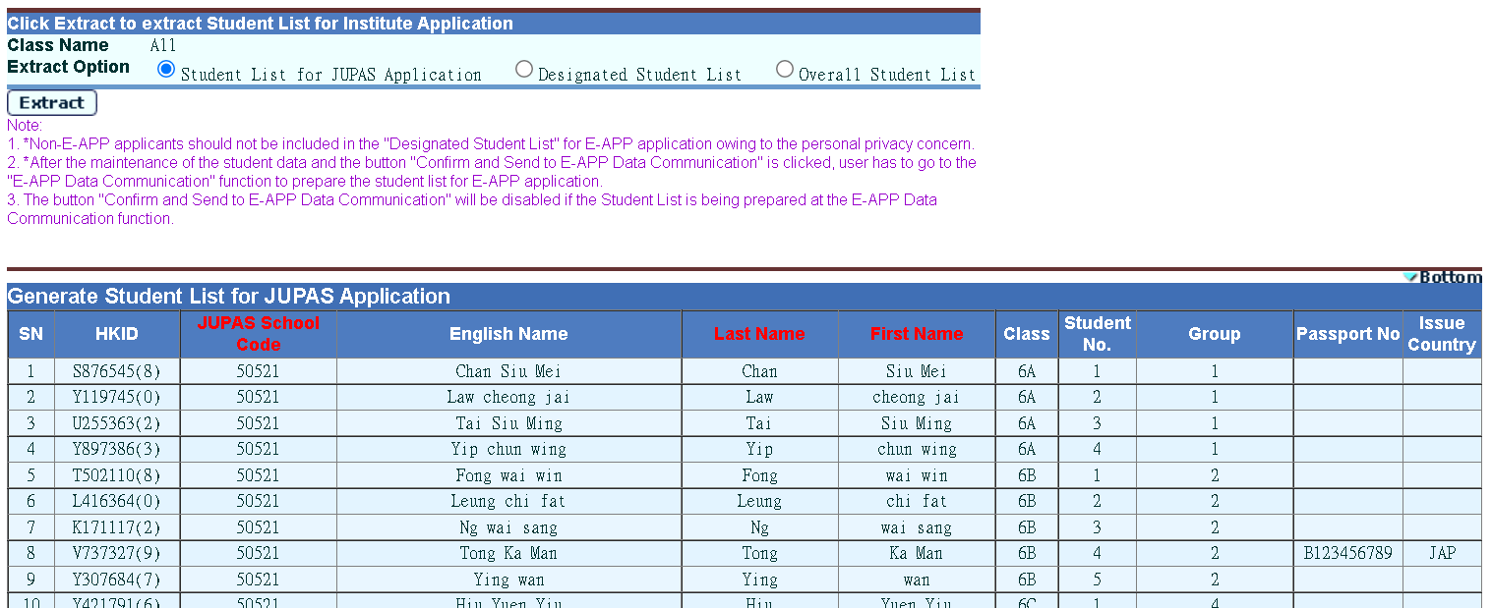
Generate Student List(5)
Institute Application > Generate Student List for Institute Application
Checking applicants before pressing [Confirm] button
1
2
3

Slide 16
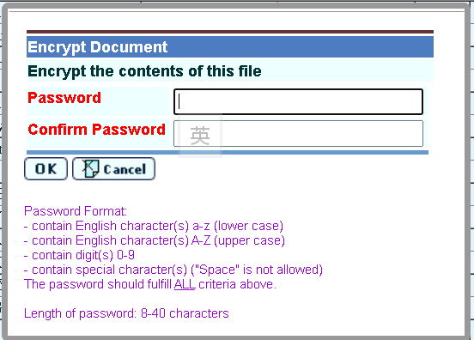

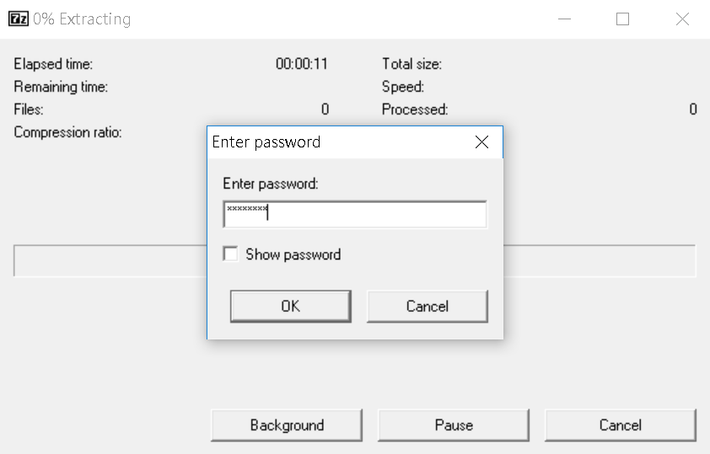
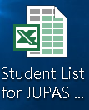
Generate Student List(6)
Institute Application > Generate Student List for Institute Application (After pressing [Confirm] button)

Slide 17
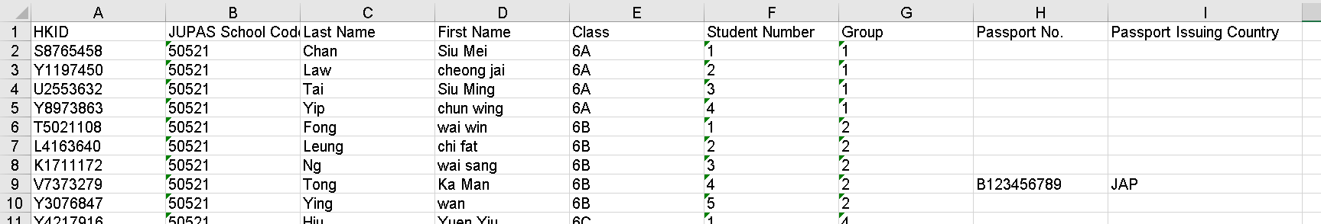
Generate Student List(7)
Institute Application > Generate Student List for Institute Application
  Submit this student information to JUPAS Office
  (https://www.jupas.edu.hk/en/)
Every applicant should have HKID for JUPAS application

Slide 18
申請大專院校
Institute Application (INA)

Slide 19
Work Flow
For extracting S6 student data for JUPAS and E-APP applications
Sep Applications for JUPAS
Student Data Extraction and School Reference Report (SRR) Generation
- Prepare Academic Performance, Personal and General Abilities and Academic Performance Supplementary Information
- Generate SRR
Student List Generation
Submit Data via JUPAS Portal
JUPAS Student Account Creation
Import Student Registration No and Subject Code to WebSAMS
School Reference Report (SRR) Submission
Export and submit Data via JUPAS Portal
Dec Applications for E-APP
Student List and SRR Generation
Extract Student Data and generate SRR
Student Data Submission
Export Student List and SRR (optional) to E-APP Portal via CDS

Slide 20
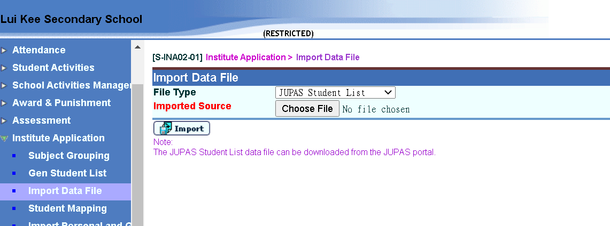
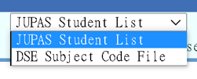
Import Data File(1)
Institute Application > Import Data File (JUPAS Student List)
(Refer to slide of Preparatory Work 2)
1
2

Slide 21
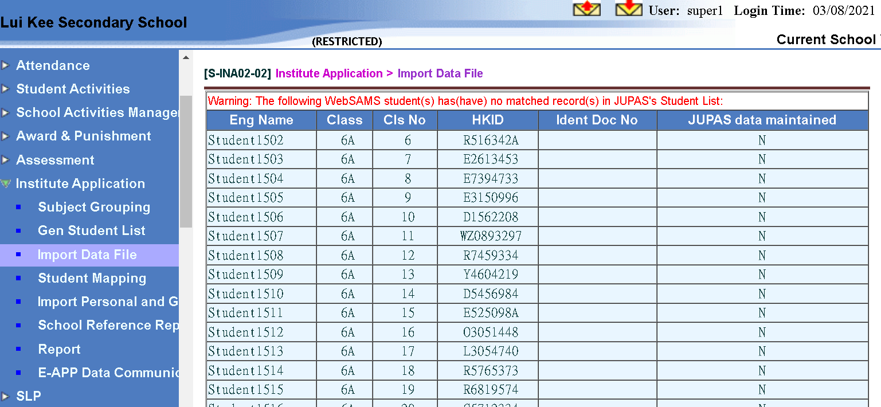
Import Data File(2)
Checking irregularities
Institute Application > Import Data File (JUPAS Student List)
3

Slide 22
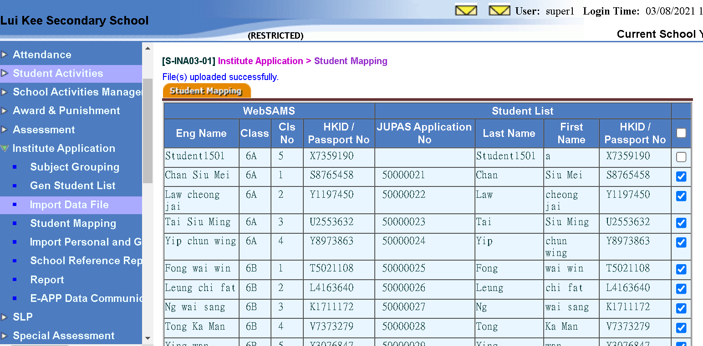
Import Data File(3)
Checking applicants
Institute Application > Import Data File (JUPAS Student List)
4
5

Slide 23
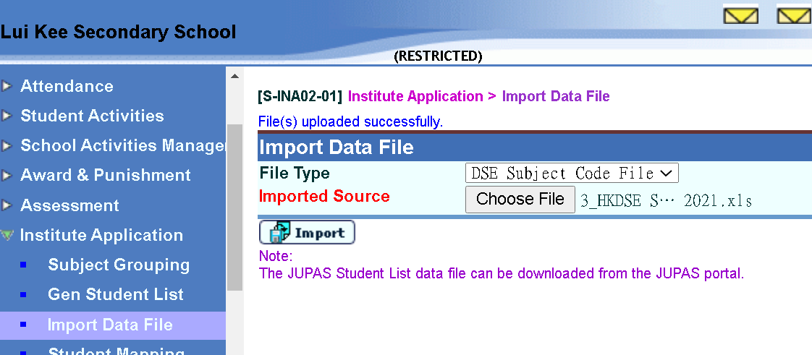
Import Data File(4)
Institute Application > Import Data File (DSE Subject Code)
  (Refer to slide of FAQ question 2)
4
1
3
2

Slide 24
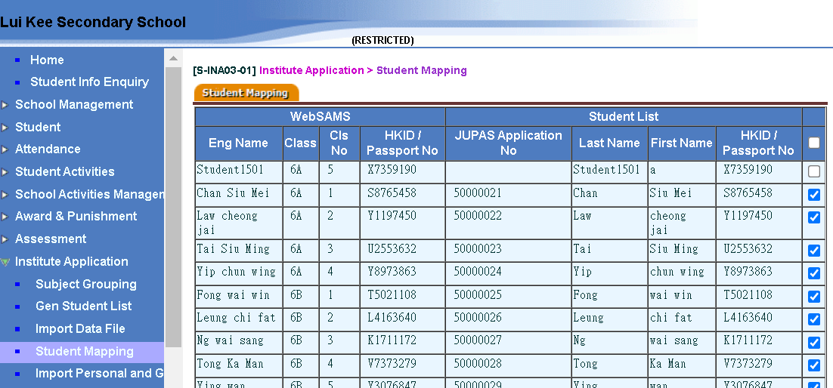
Student Mapping
Institute Application > Student Mapping
Checking applicants
Institute Application > Student Mapping
  Uncheck the applicant(s) if necessary
1
2
3

Slide 25
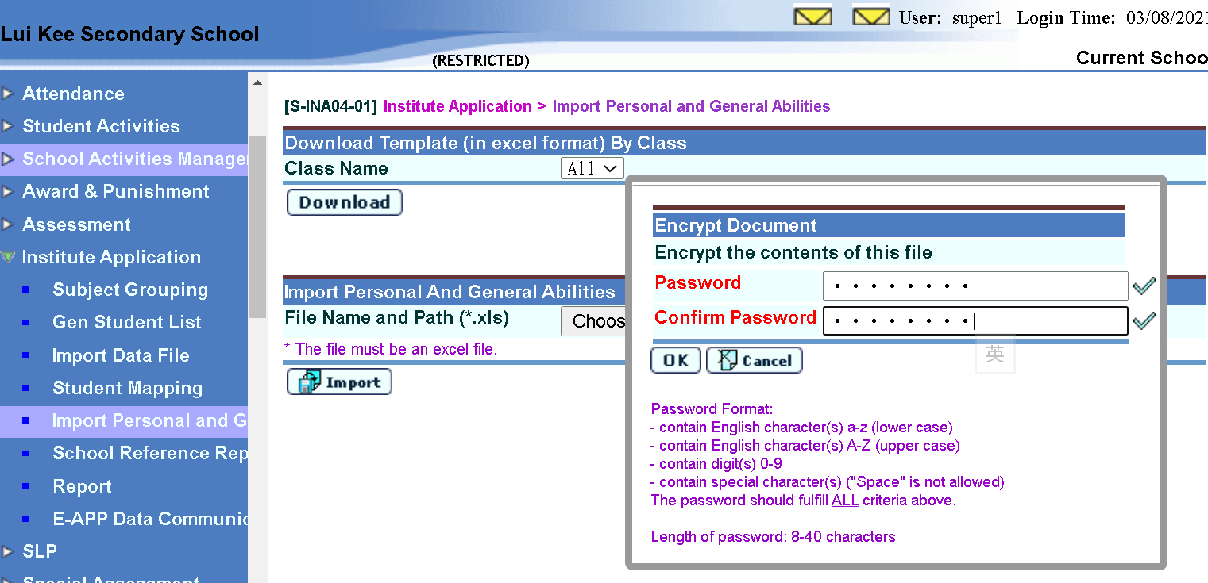
Import Personal and General Abilities(1)
Institute Application > Import Personal and General Abilities
1
2
New security requirement

Slide 26

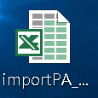
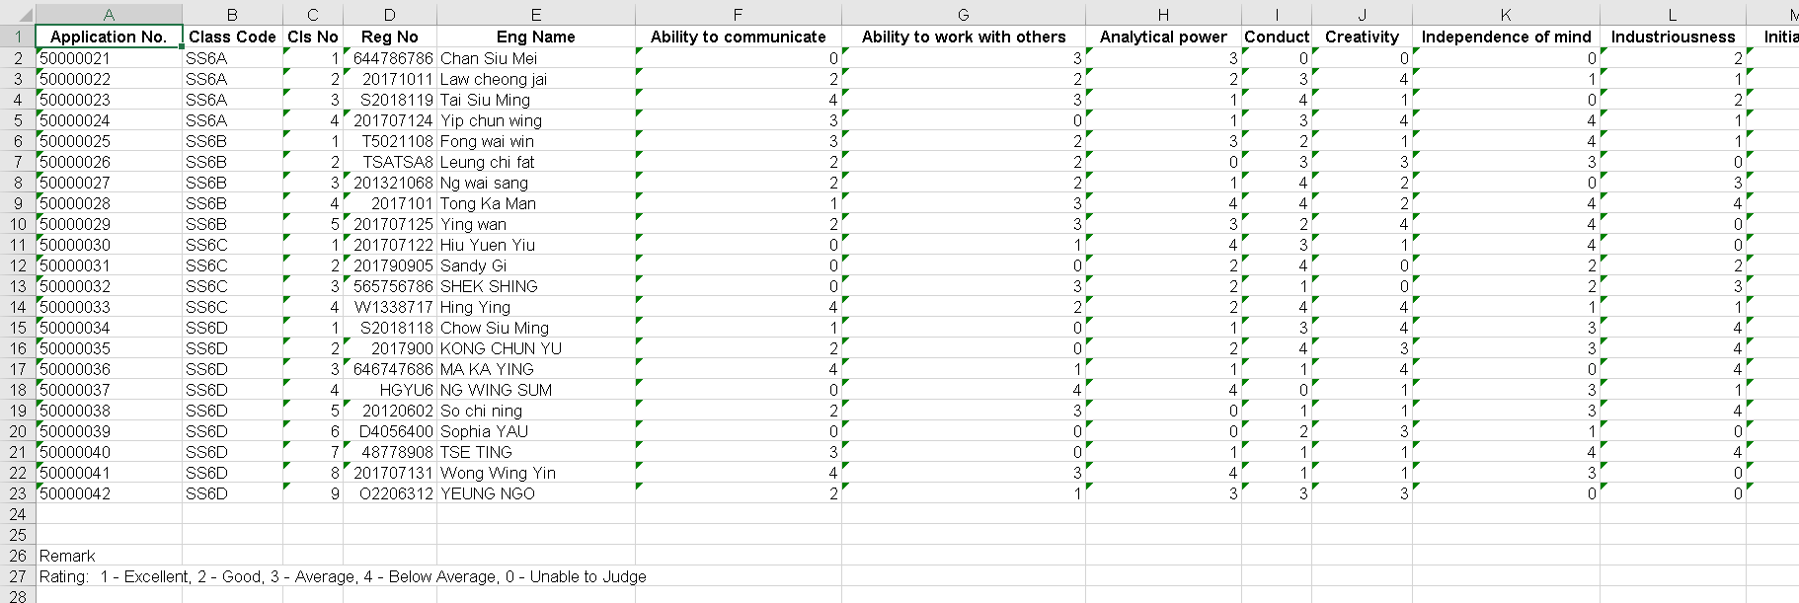
Import Personal and General Abilities(2)
Institute Application > Import Personal and General Abilities
2
13 items to be assessed
3
Reference key

Slide 27
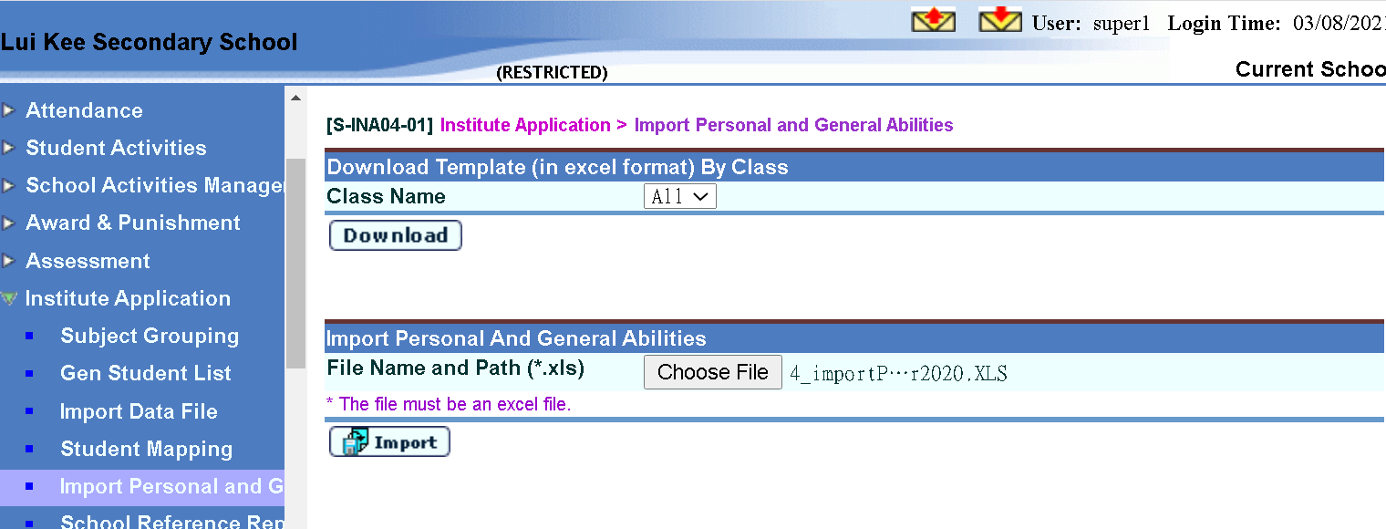
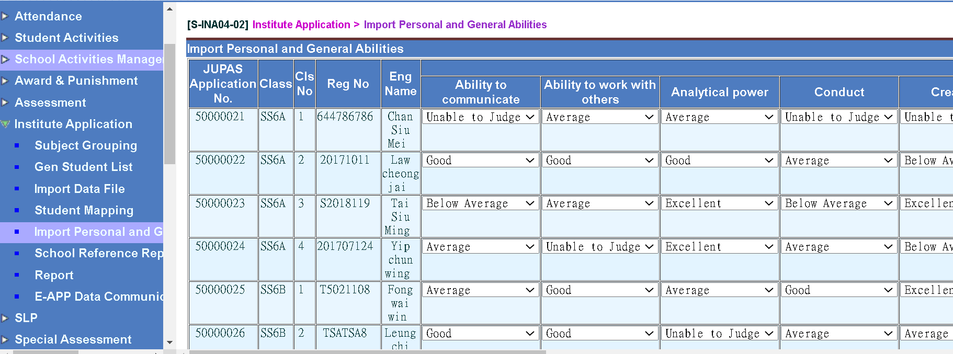
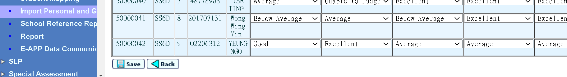
Import Personal and General Abilities(3)
Institute Application > Import Personal and General Abilities
5
4
6

Slide 28
申請大專院校
Institute Application (INA)

Slide 29
Work Flow
For extracting S6 student data for JUPAS and E-APP applications
Sep Applications for JUPAS
Student Data Extraction and School Reference Report (SRR) Generation
- Prepare Academic Performance, Personal and General Abilities and Academic Performance Supplementary Information
- Generate SRR
Student List Generation
Submit Data via JUPAS Portal
JUPAS Student Account Creation
Import Student Registration No and Subject Code to WebSAMS
School Reference Report (SRR) Submission
Export and submit Data via JUPAS Portal
Dec Applications for E-APP
Student List and SRR Generation
Extract Student Data and generate SRR
Student Data Submission
Export Student List and SRR (optional) to E-APP Portal via CDS

Slide 30
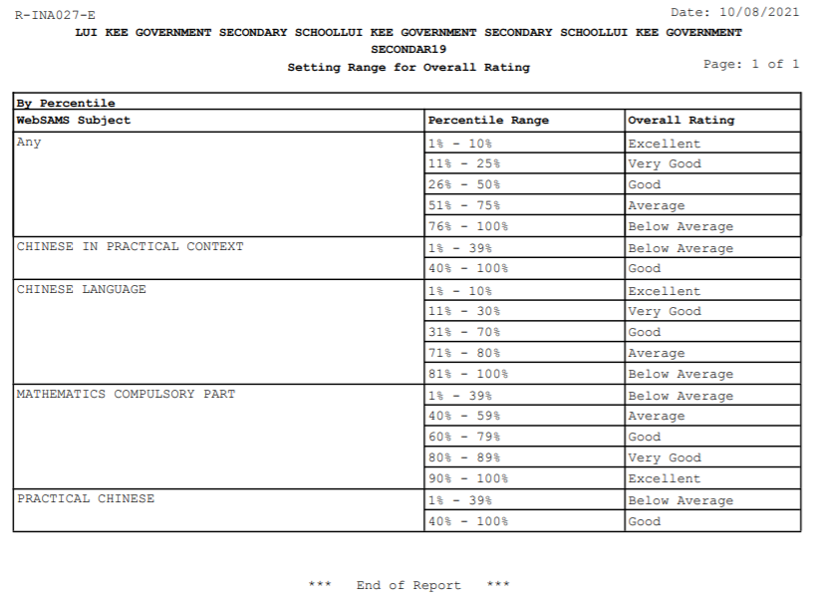
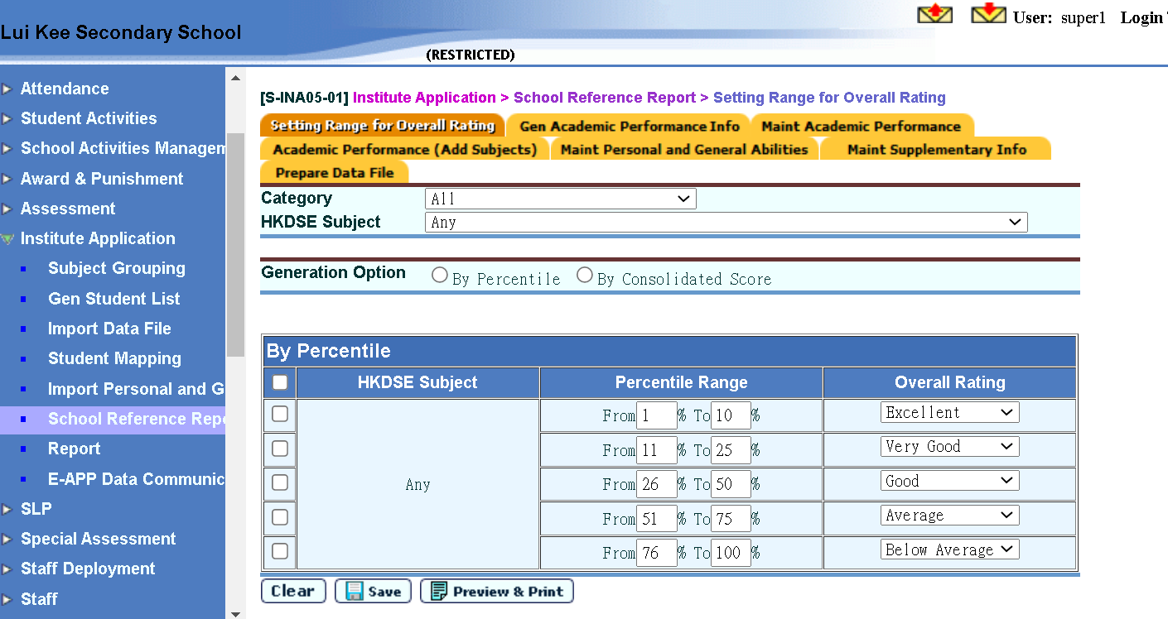
School Reference Report(SRR)(1)
Institute Application > School Reference Report > Setting Range for Overall Rating
1
2
3
4
5

Slide 31
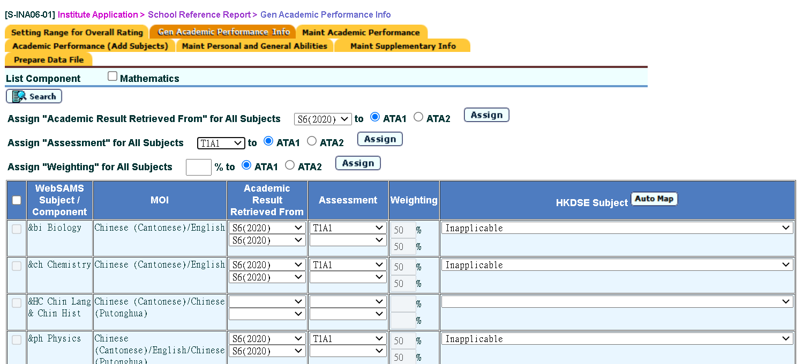
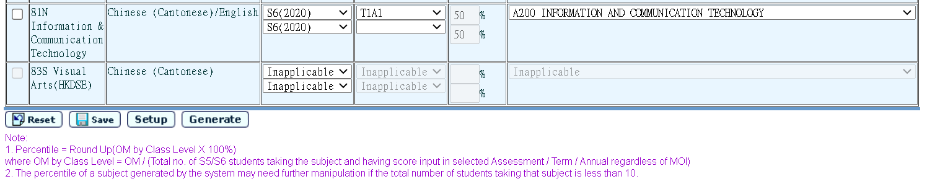
School Reference Report(SRR)(2)
Institute Application > School Reference Report > Gen Academic Performance Info (Press [Generate] to extract results from ASR; refer to slide of Preparatory Work 3)
Choose the BEST results for applicants
1 (Check box for subject component level)
4
3
5
2

Slide 32
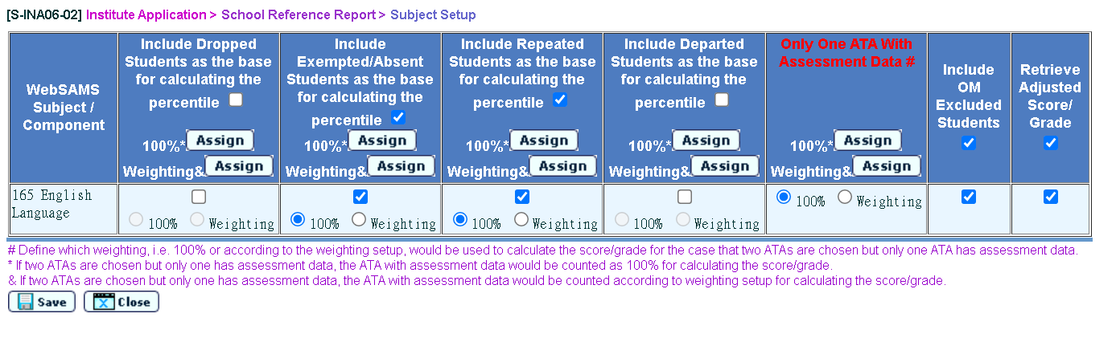
School Reference Report(SRR)(3)
Institute Application > School Reference Report > Gen Academic Performance Info (Check the subject(s) and press [Setup] to fine-tune percentile calculation)
3
1
2
4

Slide 33
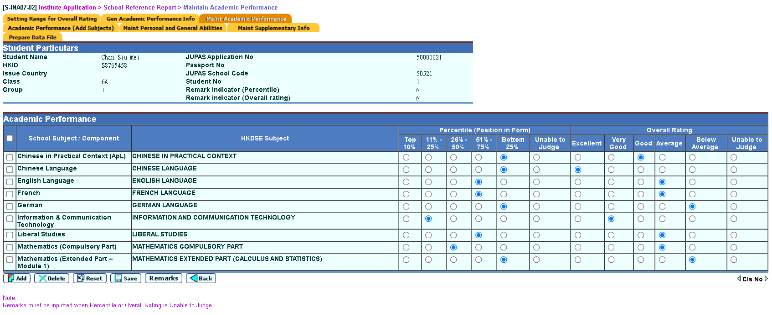
School Reference Report(SRR)(4)
Institute Application > School Reference Report > Search Student (Fine-tune student’s Academic Performance)
1
2
3

Slide 34
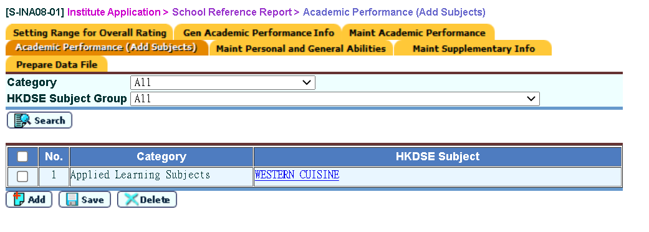
School Reference Report(SRR)(5)
Institute Application > School Reference Report > Academic Performance (Add Subjects if necessary)
1
3
2
4

Slide 35
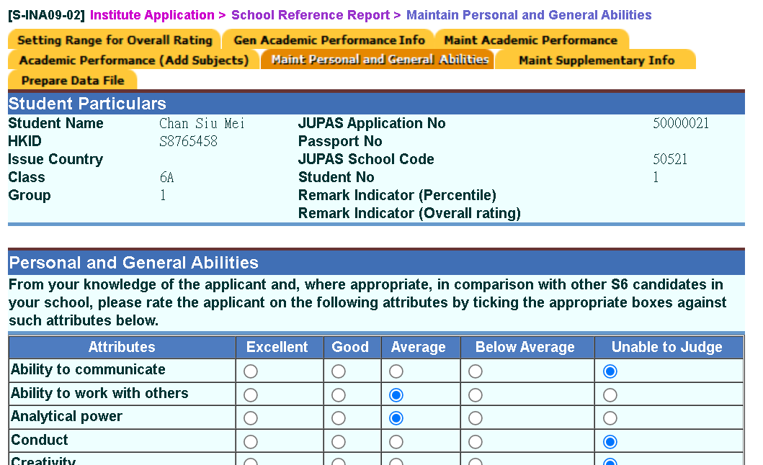
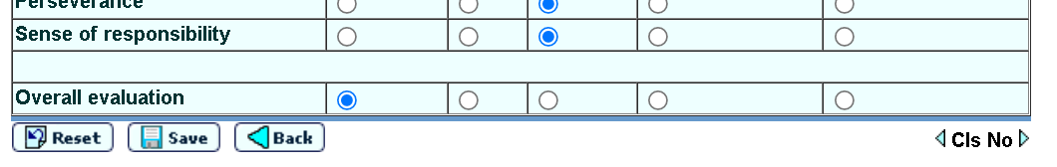
School Reference Report(SRR)(6)
Institute Application > School Reference Report > Search Student (Fine-tune student’s Personal & General Abilities)
1
2
3

Slide 36
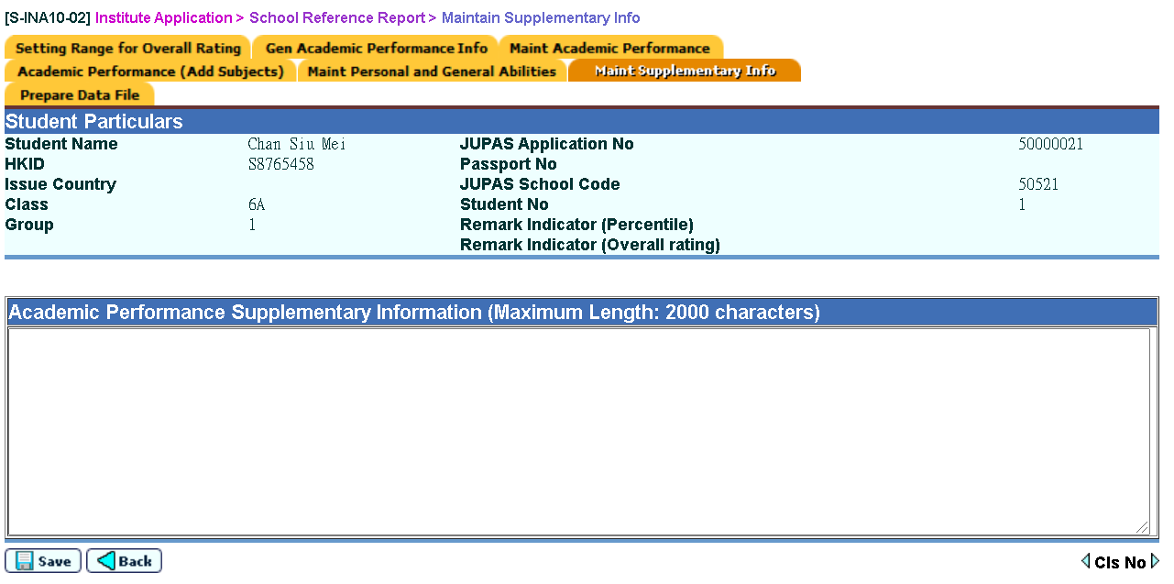
School Reference Report(SRR)(7)
Institute Application > School Reference Report > Search Student (Highlight student’s extra Academic Performance)
1
2
3

Slide 37
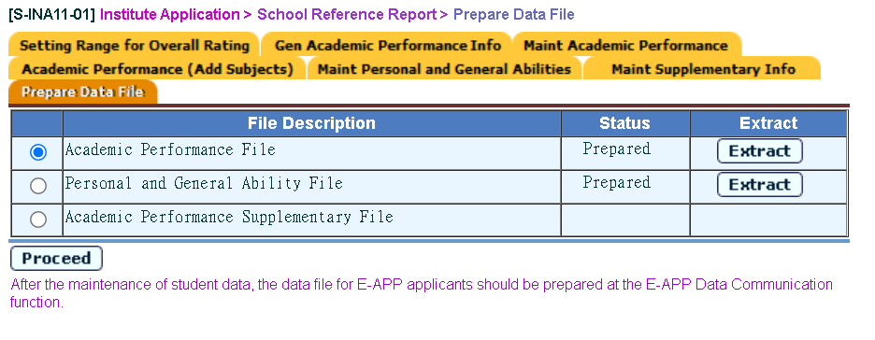
School Reference Report(SRR)(8)
Institute Application > School Reference Report > Prepare Data File
1
2

Slide 38
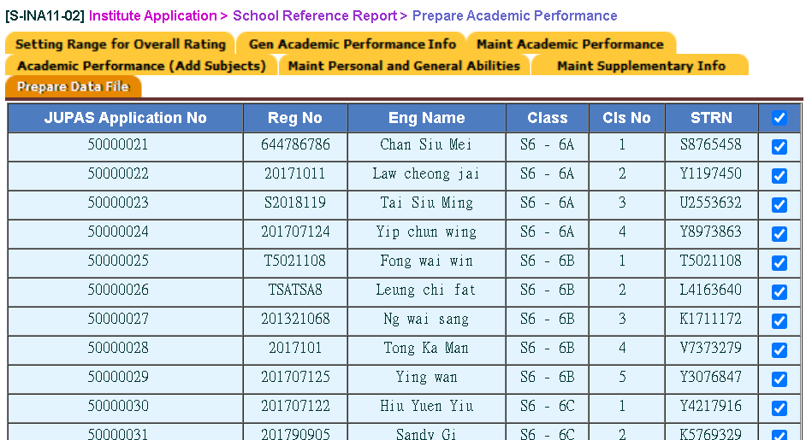
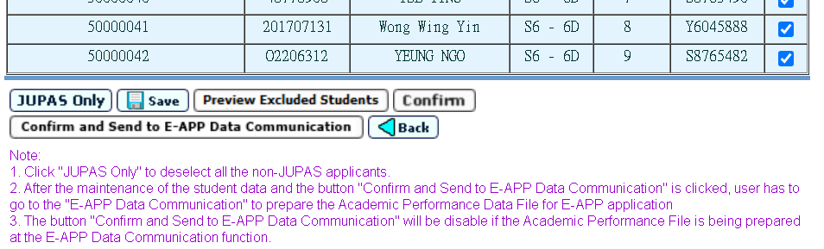
School Reference Report(SRR)(9)
Institute Application > School Reference Report > Prepare Data File (Select appropriate applicants)
Note of first working step for JUPAS submission

Slide 39
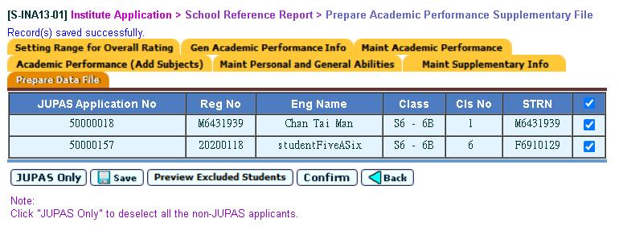
School Reference Report(SRR)(10)
Institute Application > School Reference Report > Prepare Data File (Select appropriate applicants)
2
1
3
4

Slide 40
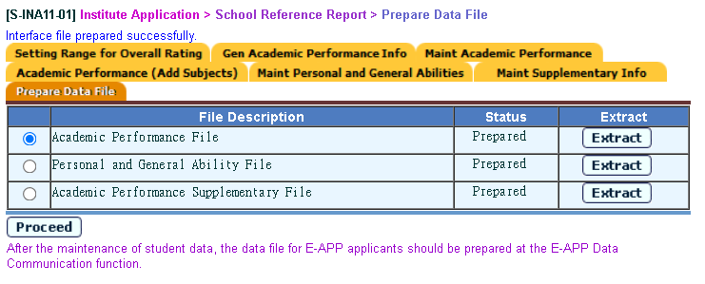
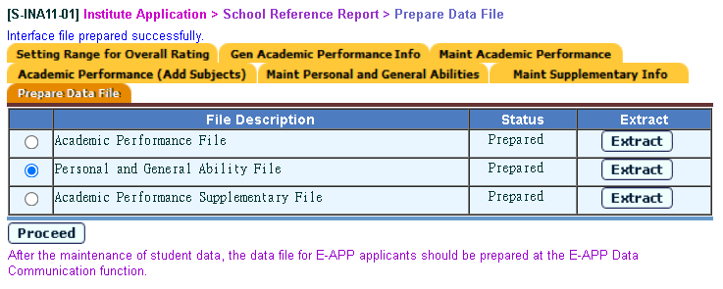
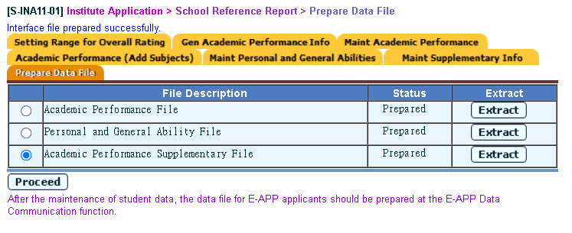
School Reference Report(SRR)(11)
Institute Application > School Reference Report > Prepare Data File
4

Slide 41
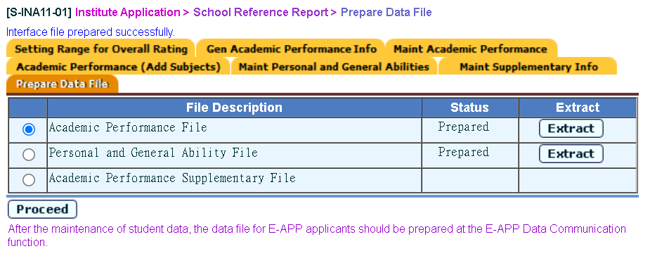
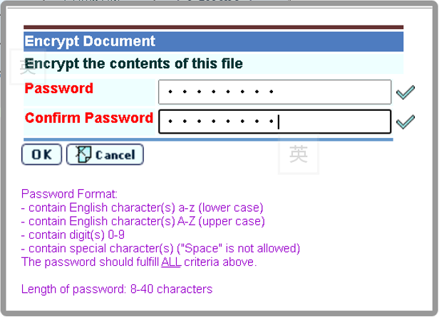
School Reference Report(SRR)(12)
Institute Application > School Reference Report > Prepare Data File (Extract three data files and send to JUPAS Office)
4
5
6

Slide 42
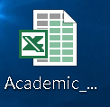

School Reference Report(SRR)(13)
Institute Application > School Reference Report > Prepare Data File (Extract three data files and send to JUPAS Office)
6
7

Slide 43
申請大專院校
Institute Application (INA)

Slide 44
Work Flow
For extracting S6 student data for JUPAS and E-APP applications
Sep Applications for JUPAS
Student Data Extraction and School Reference Report (SRR) Generation
- Prepare Academic Performance, Personal and General Abilities and Academic Performance Supplementary Information
- Generate SRR
Student List Generation
Submit Data via JUPAS Portal
JUPAS Student Account Creation
Import Student Registration No and Subject Code to WebSAMS
School Reference Report (SRR) Submission
Export and submit Data via JUPAS Portal
Dec Applications for E-APP
Student List and SRR Generation
Extract Student Data and generate SRR
Student Data Submission
Export Student List and SRR (optional) to E-APP Portal via CDS

Slide 45
E-APP
Operation Procedures

Slide 46
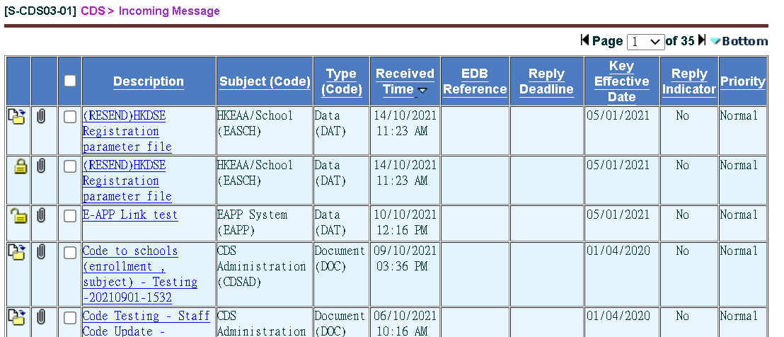



Process Incoming Data
Institute Application > E-APP Data Communication > Process Incoming Data
  Decrypt Parameter File which was sent from E-APP System(EDB) via CDS

Slide 47
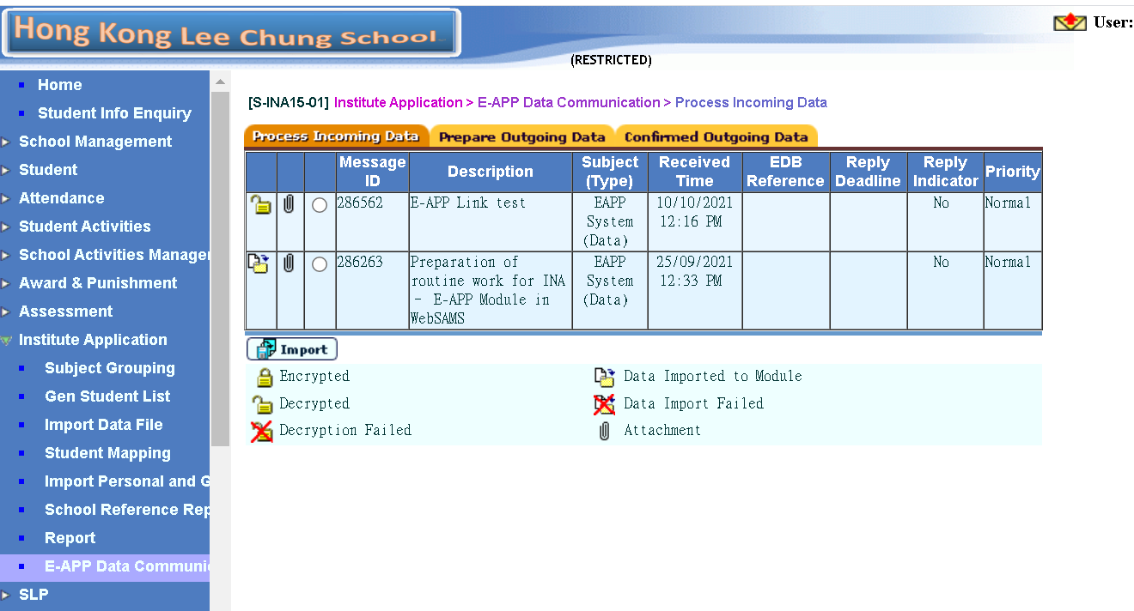


Process Incoming Data
Institute Application > E-APP Data Communication > Process Incoming Data
  Decrypt and import Parameter File which was sent from E-APP System(EDB) via CDS
Parameter file for
2021/22
1
Parameter file for
2020/21
2

Slide 48
Generate Designated Student List(1)
Institute Application > Generate Student List for Institute Application
1
2

Slide 49
Generate Designated Student List(2)
Institute Application > Generate Student List for Institute Application
2
1

Slide 50
Generate Designated Student List(3)
Institute Application > Generate Student List for Institute Application
Data under columns with header labels in red are needed to be input

Slide 51
Generate Designated Student List(4)
Institute Application > Generate Student List for Institute Application
1
2
3
4
Enter School Code (without JUPAS School Code) for E-APP

Slide 52
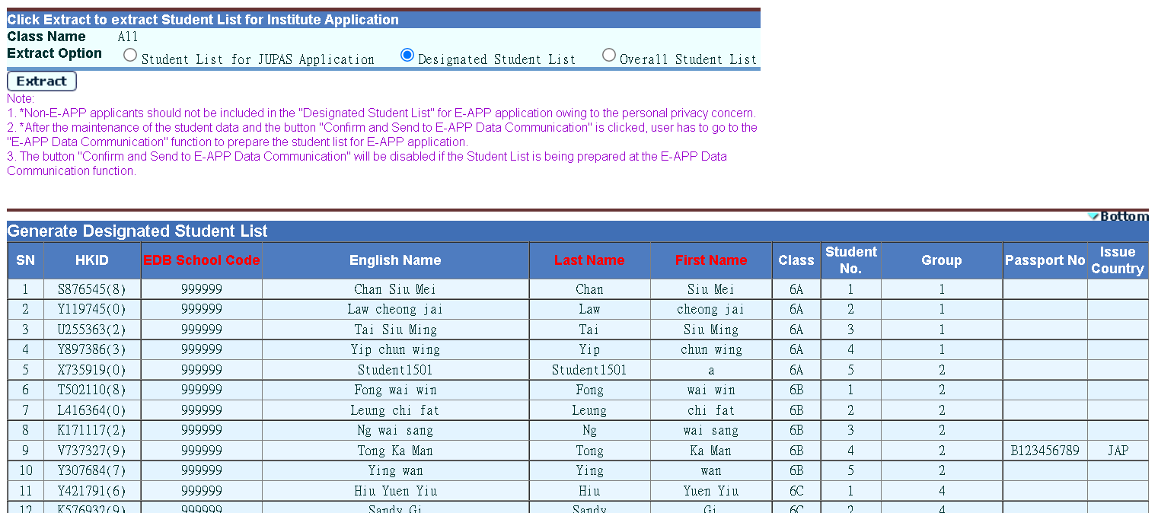
Generate Designated Student List(5)
Institute Application > Generate Student List for Institute Application
Checking applicants before pressing [Confirm] button
1
2
3
4

Slide 53
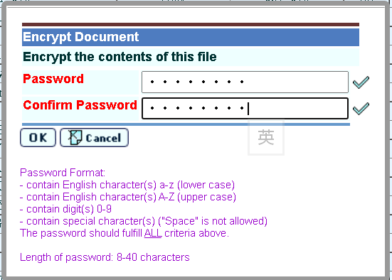


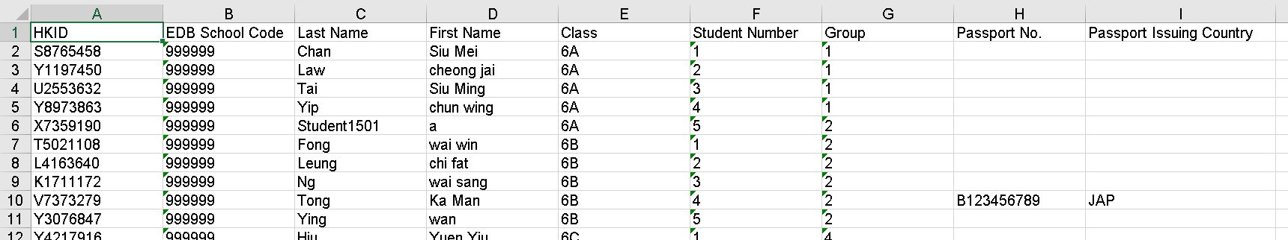
Generate Designated Student List(6)
Institute Application > Generate Student List for Institute Application (After pressing [Confirm] button)

Slide 54
申請大專院校
Institute Application (INA)

Slide 55
Work Flow
For extracting S6 student data for JUPAS and E-APP applications
Sep Applications for JUPAS
Student Data Extraction and School Reference Report (SRR) Generation
- Prepare Academic Performance, Personal and General Abilities and Academic Performance Supplementary Information
- Generate SRR
Student List Generation
Submit Data via JUPAS Portal
JUPAS Student Account Creation
Import Student Registration No and Subject Code to WebSAMS
School Reference Report (SRR) Submission
Export and submit Data via JUPAS Portal
Dec Applications for E-APP
Student List and SRR Generation
Extract Student Data and generate SRR
Student Data Submission
Export Student List and SRR (optional) to E-APP Portal via CDS

Slide 56



Prepare Academic Performance File
Institute Application > School Reference Report > Prepare Data File (Refer to previous slides for making SRR first)
Note of working steps for data file preparation
1
2
3
4
5

Slide 57

Prepare Personal & General Ability File
Institute Application > School Reference Report > Prepare Data File (Refer to previous slides for making SRR first)
Note of working steps for data file preparation
1
2
3
4
5

Slide 58

Prepare & Confirm Outgoing Data(1)
Institute Application > E-APP Data Communication > Prepare Outgoing Data
1
2
3
Note of working steps for E-APP
5
4
6

Slide 59

Prepare & Confirm Outgoing Data(2)
Institute Application > E-APP Data Communication > Prepare Outgoing Data
1
2
3
4
5
6

Slide 60

Prepare & Confirm Outgoing Data(3)
Institute Application > E-APP Data Communication > Prepare Outgoing Data
1
2
3
4
5
6

Slide 61

Prepare & Confirm Outgoing Data(4)
Institute Application > E-APP Data Communication > Prepare Outgoing Data
1
2
3
4
5
6

Slide 62

Prepare & Confirm Outgoing Data(5)
Institute Application > E-APP Data Communication > Prepare Outgoing Data
Reminder of working step after confirming ALL data files

Slide 63


Confirmed Outgoing Data(1)
CDS > Outgoing Message > Maintain Message

Slide 64





Confirmed Outgoing Data(2)
CDS > Outgoing Message > Maintain Message

Slide 65



Confirmed Outgoing Data(3)
Institute Application > E-APP Data Communication > Confirmed Outgoing Data
Follow-up at E-APP Portal

Slide 66

Report
Institute Application > Report

Slide 67

網上系統資料庫 - 模組參考資料
主頁>模組資料>申請大專院校(INA)

Slide 68

網上系統資料庫 - 模組參考資料

Slide 69



常見問題(FAQ)
主頁 > 模組資料 > 申請大專院校(INA)
常見問題
1.
2.

Slide 70

主要功能新增項目
主頁>模組資料>模組訊息>網上校管系統主要功能新增項目(中文版)

Slide 71

學生成績模組近年主要功能新增項目

Slide 72
有用資料
    JUPAS Office
    Enquiry Hotline: 2334 2929 / 2233 2929
Email: info@jupas.edu.hk
    專上課程預先報名平台
  電話 : 3104 2560
  電郵 : eapp_post_sec@edb.gov.hk

Slide 73
完

